Slide 1
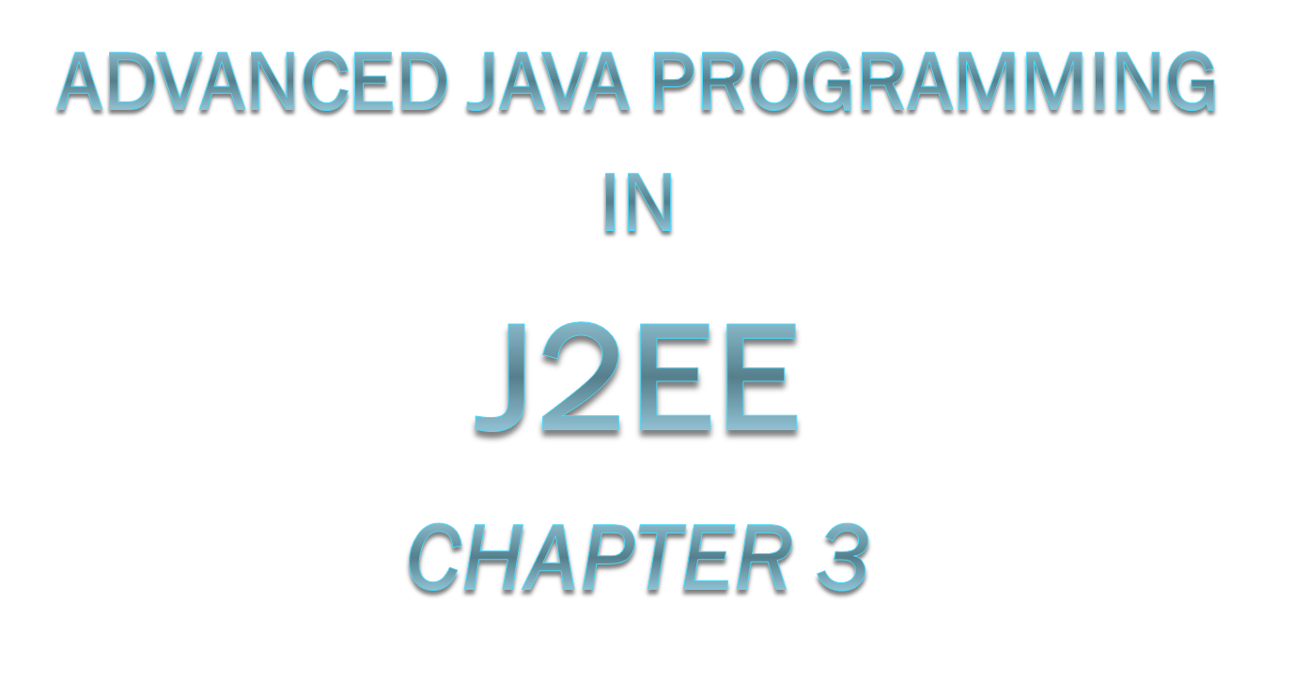

Notes:
Book Reference: The Java EE 6Tutorial – By Oracle
Part No: 821–1841–15
April 2012

Slide 2

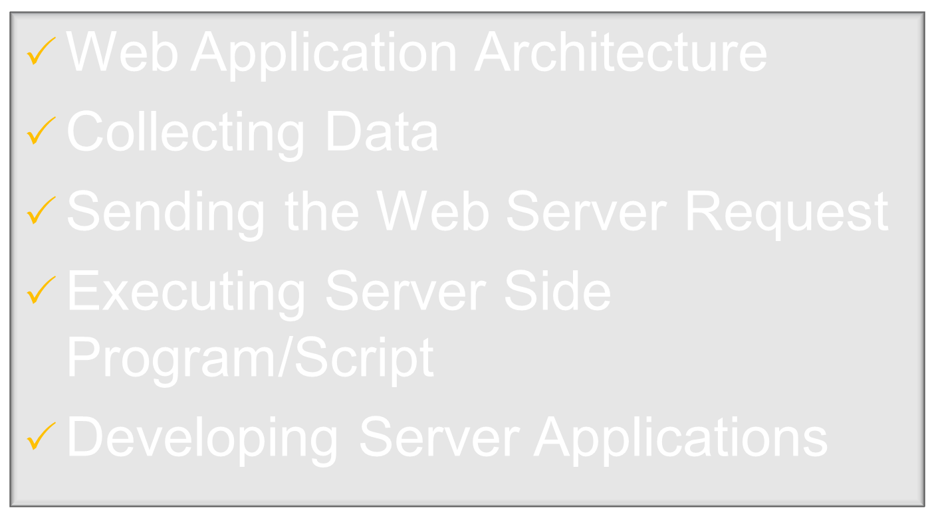
We will not follow above topics, we will learn Web Application as we can easily get it.
Notes:
Ch.3 Topics → from Sau Uni MCA-III Syllabus.

Slide 3

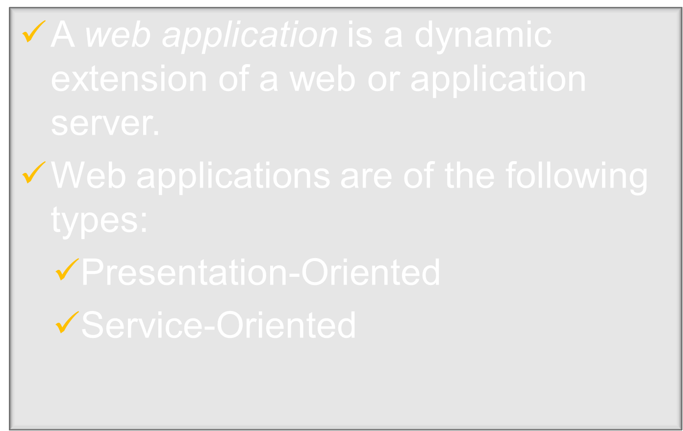
Notes:
Pg. No. 81

Slide 4

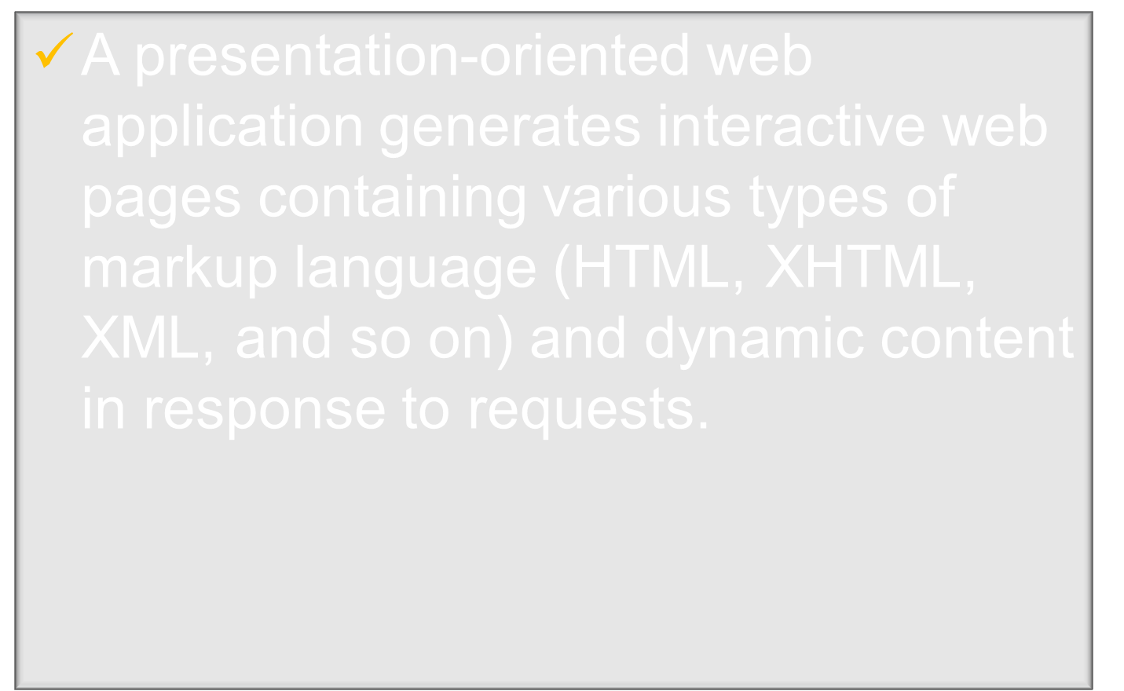
Notes:
Pg. No. 81

Slide 5

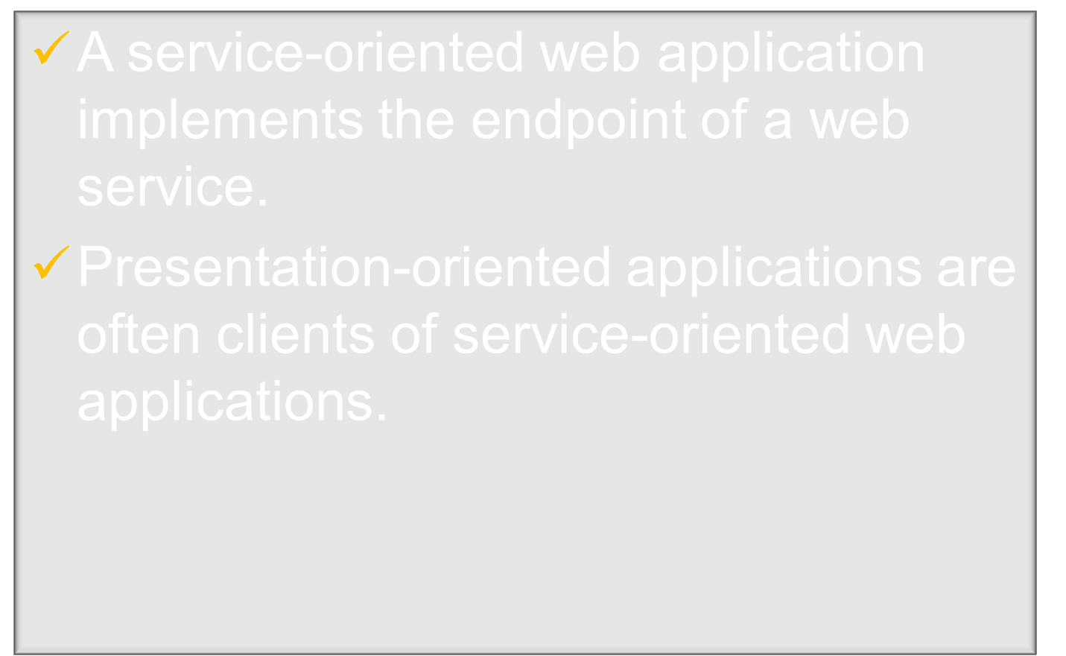
Notes:
Pg. No. 81

Slide 6

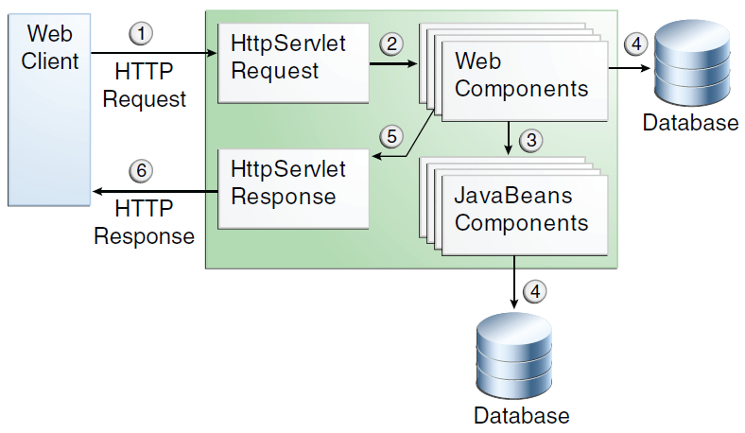

Notes:
Pg. No. 82

Slide 7

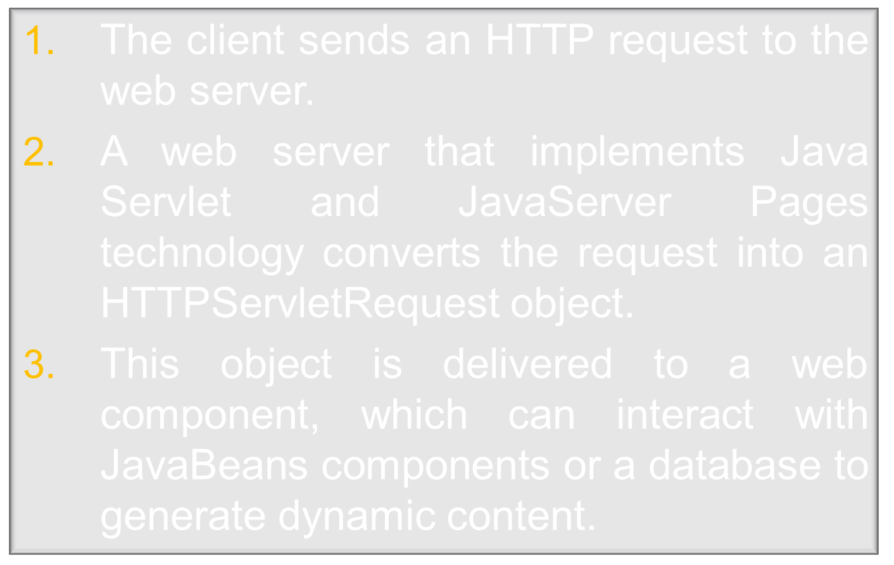
Notes:
Pg. No. 81

Slide 8
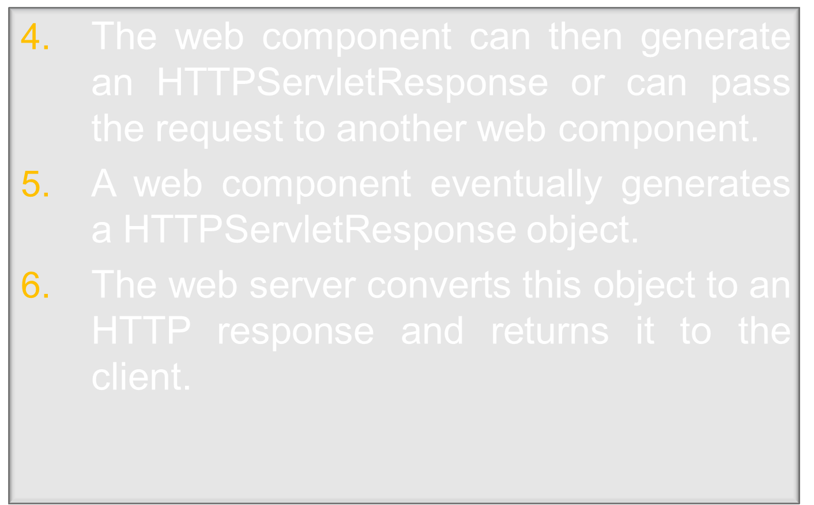
Notes:
Pg. No. 82

Slide 9

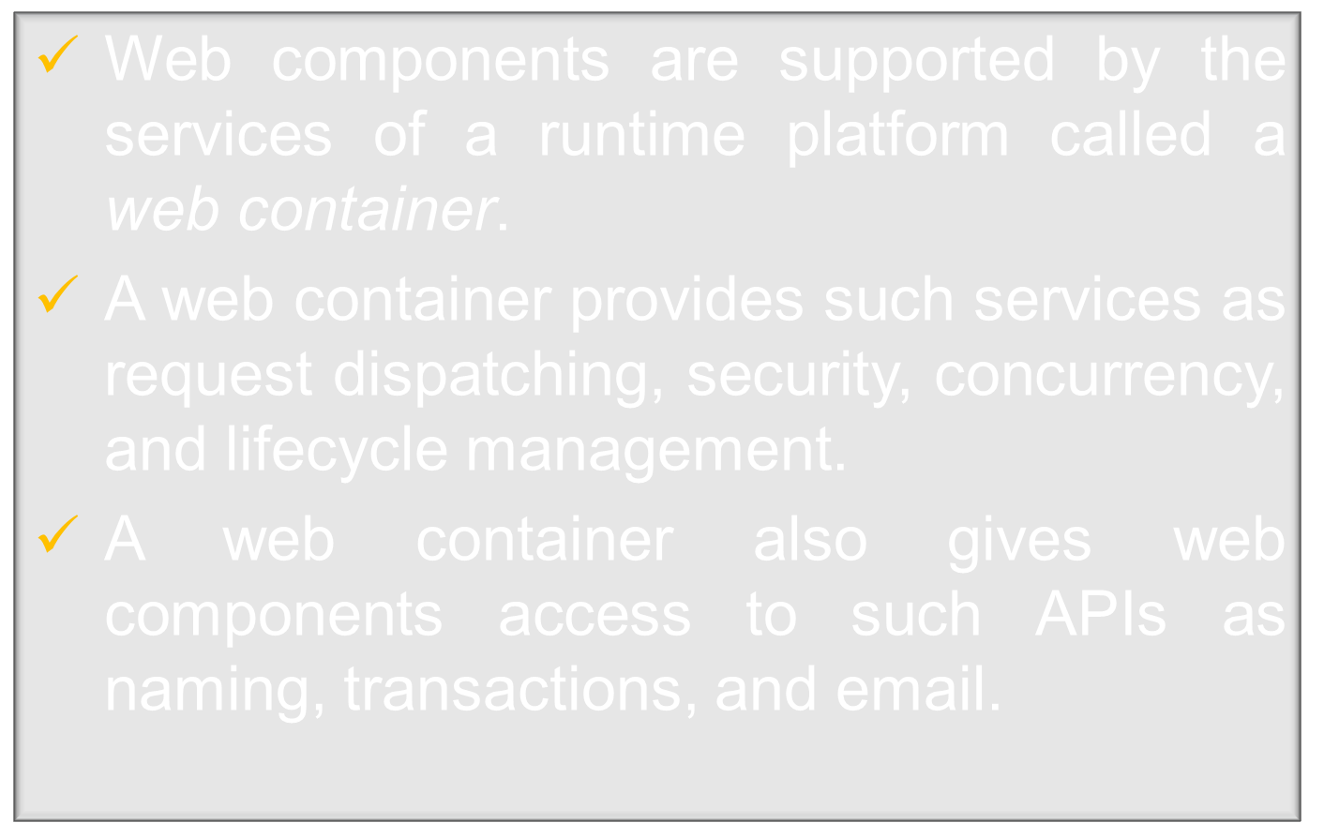
Notes:
Pg. No. 82

Slide 10
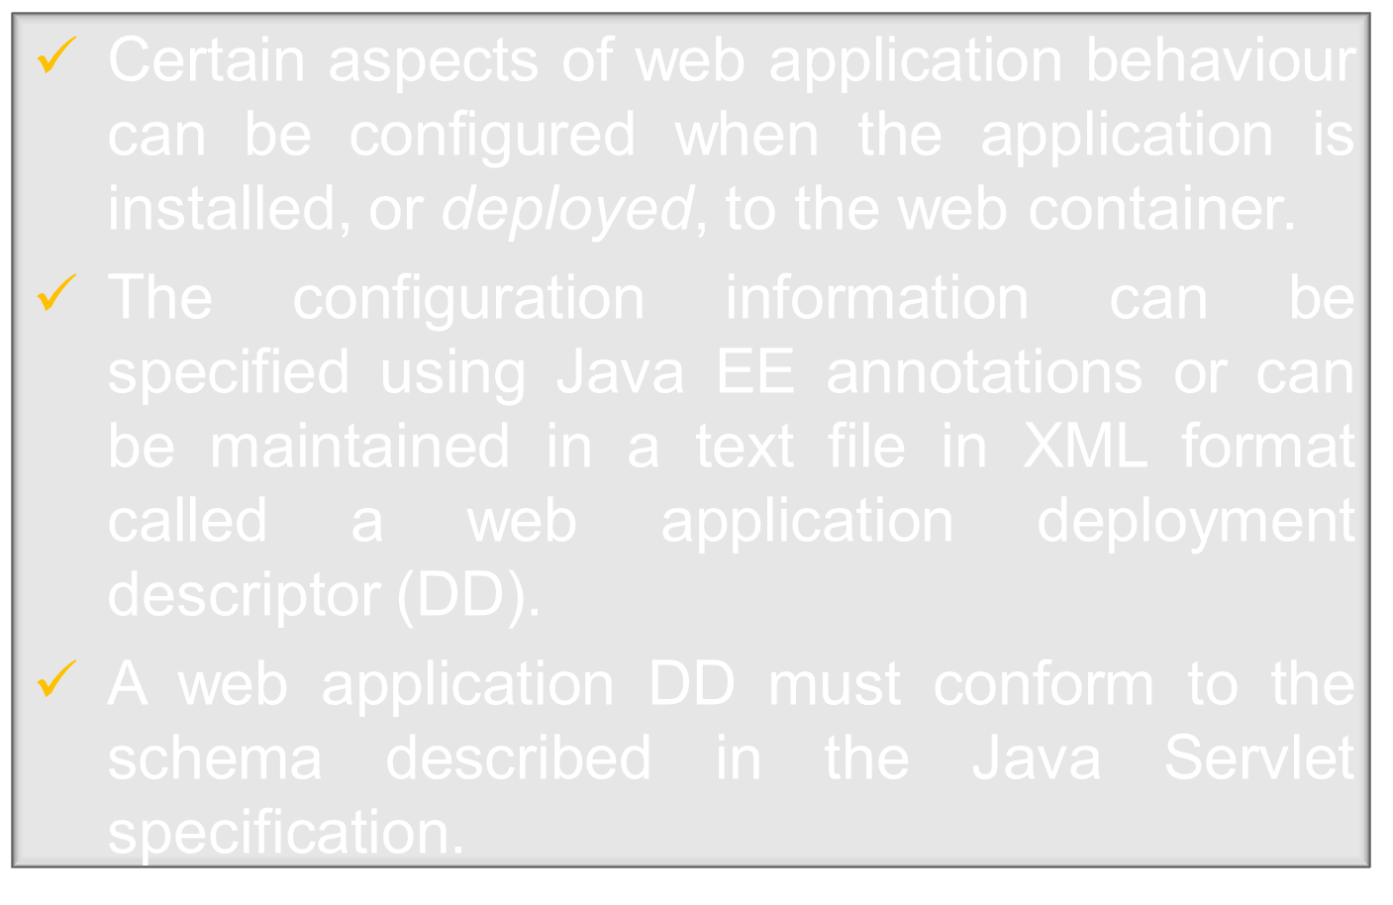
Notes:
Pg. No. 82

Slide 11

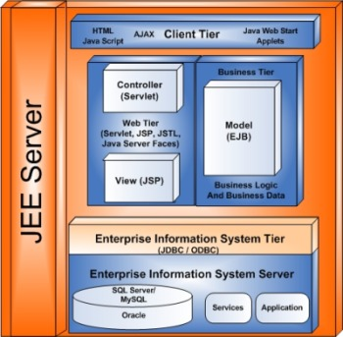

Slide 12

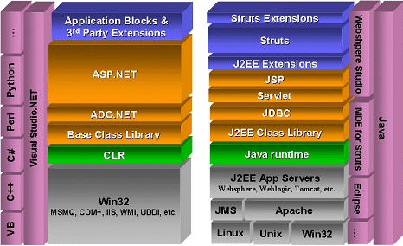

Slide 13

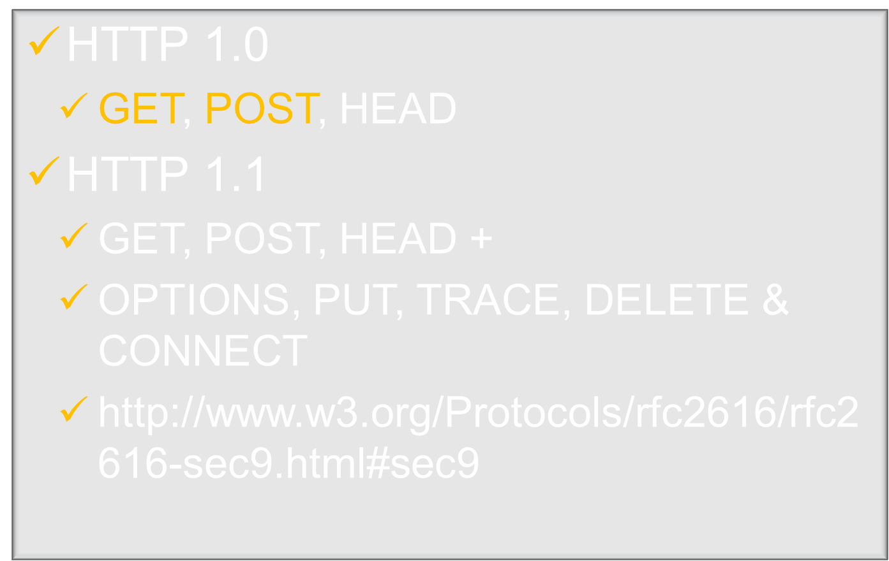

Slide 14

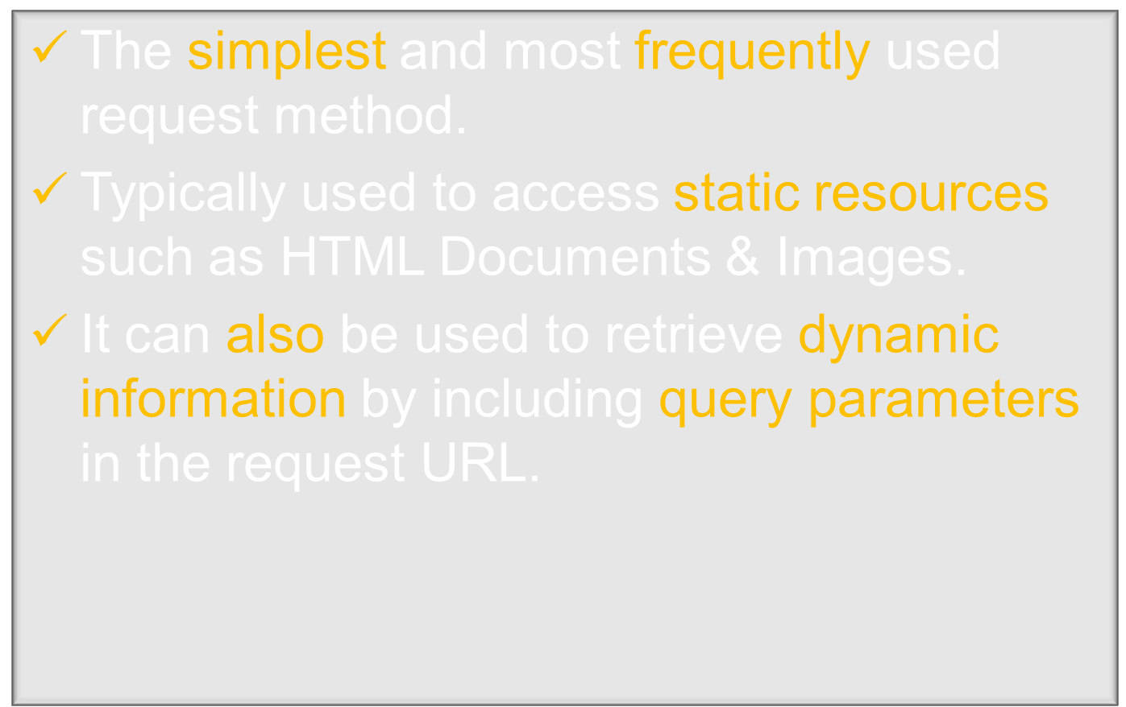

Slide 15

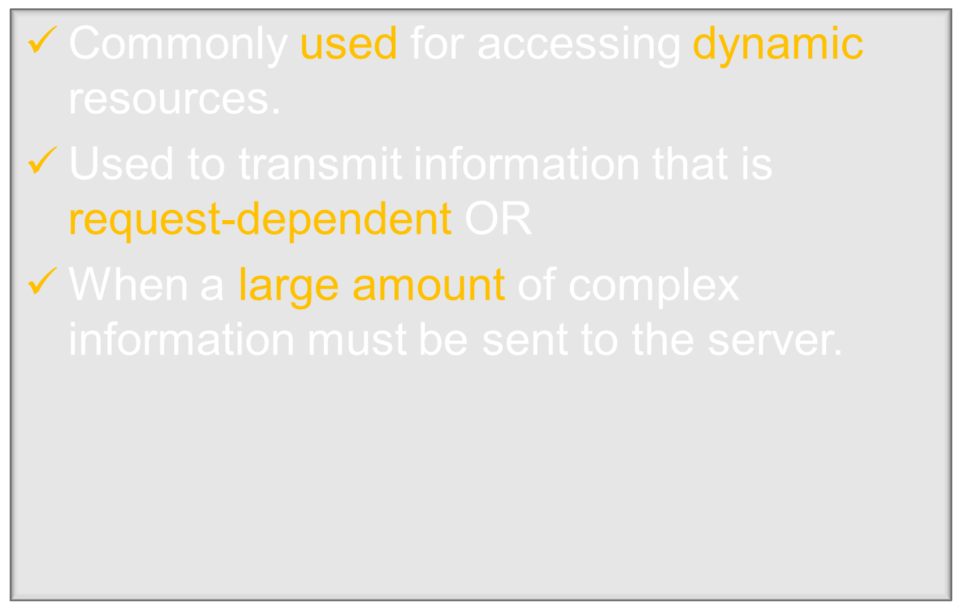

Slide 16

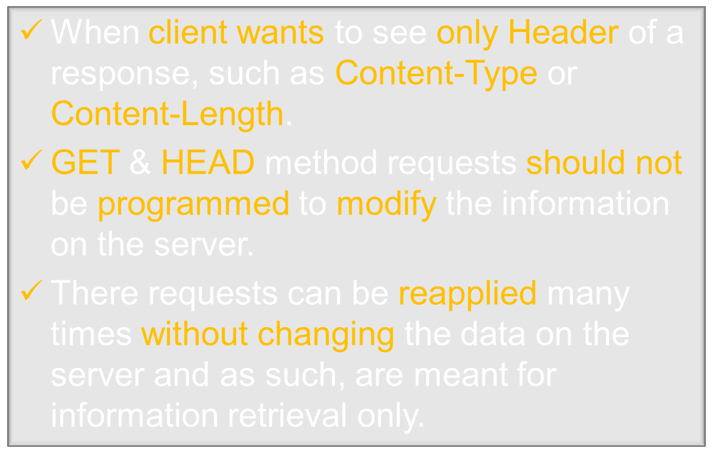

Slide 17
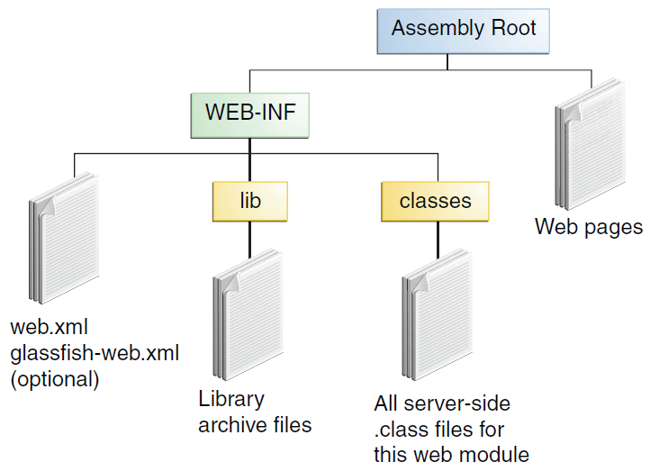

Slide 18

The Java EE 6 Tutorial
  – Oracle
  – http://download.oracle.com/javaee
  /6/tutorial/doc/javaeetutorial6.pdf

